Slide 1
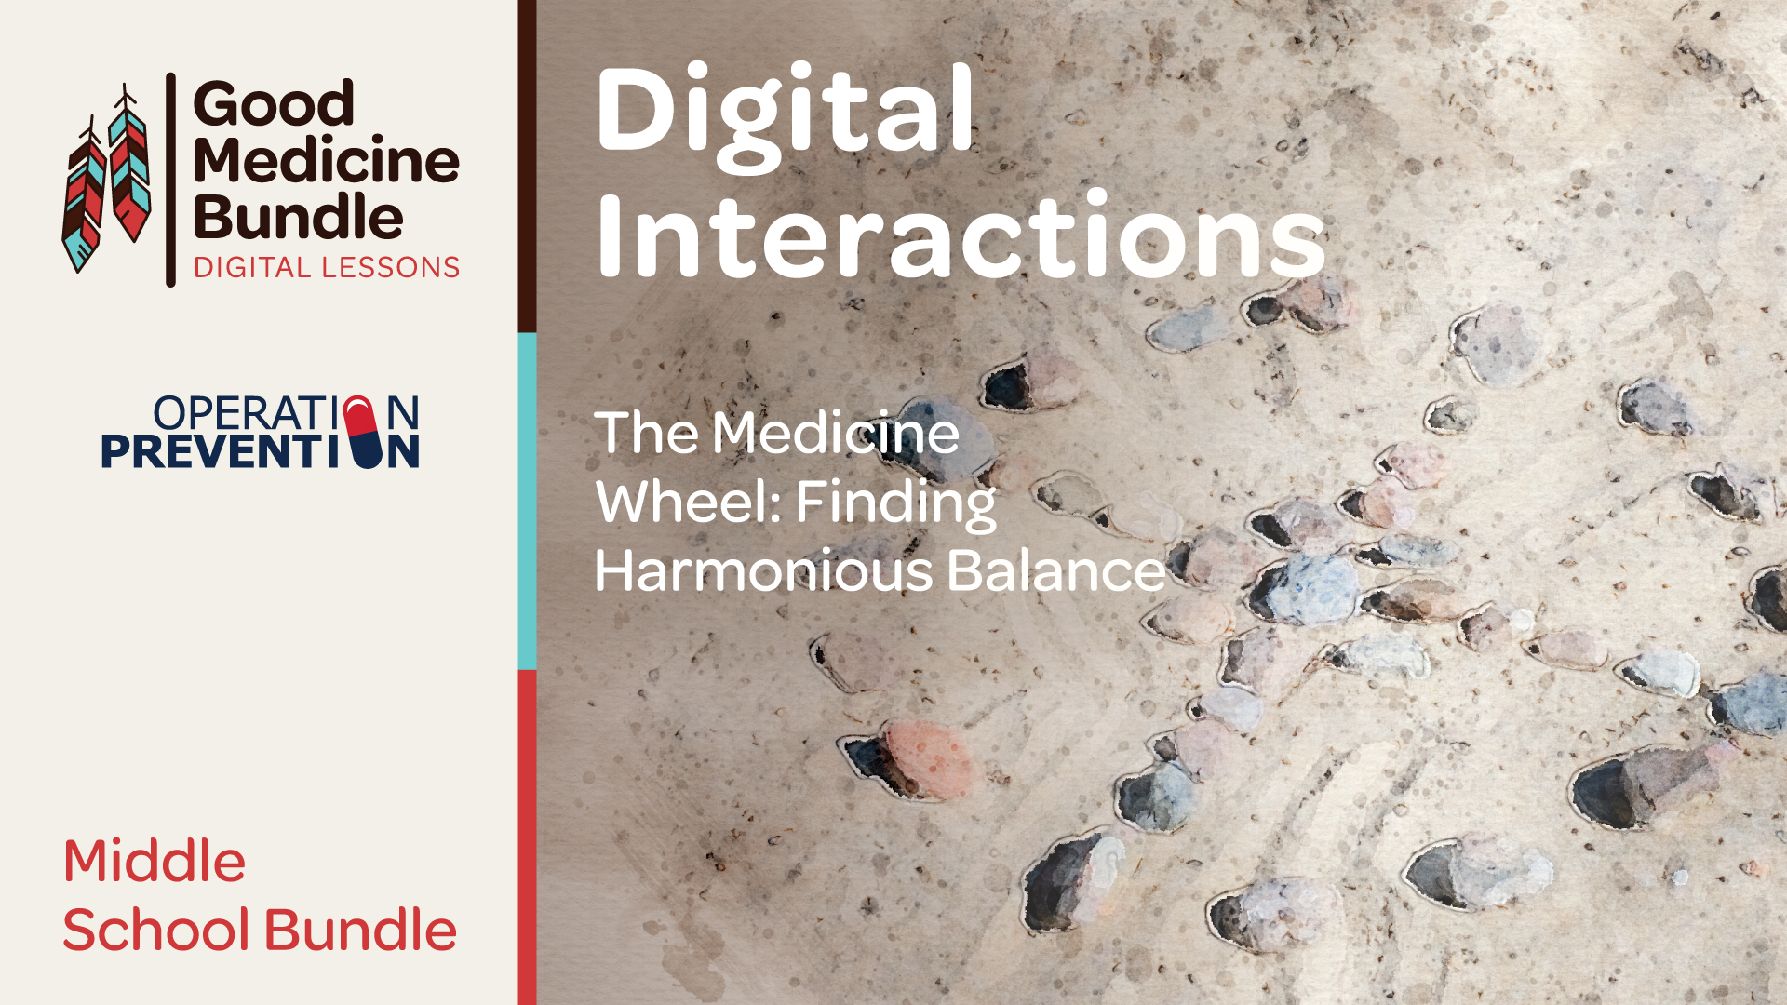

Slide 2
Objectives
Students will:
Recognize the concept of historical trauma and discuss how historical trauma can be connected to stress and imbalance in our lives.
Explore the four quadrants of the Medicine Wheel and think about how the physical, emotional, intellectual, and spiritual aspects of the Medicine Wheel can guide one toward balance and harmony in life.
Design their own Medicine Wheel that represents their own identity.
Discuss what a classroom or type of community needs to stay in balance, what kinds of things can create imbalance, and the role that they play in keeping the community harmonious and balanced.
Notes:
Teacher Notes
Introduce the lesson and discuss the objectives with students.
If your classroom and community is not part of an American Indian/Alaska Native community, or not near one, this is an opportunity to ask students what they know about AI/AN peoples and ensure that they know that there are many modern AI/AN communities and people who are still in existence and thriving today.

Slide 3
How can a Traditional Medicine Wheel help us to live a balanced and harmonious life?
Notes:
Teacher Notes:
For slide three, share with students that by the end of the lesson series, they will be able to answer this essential question.

Slide 4
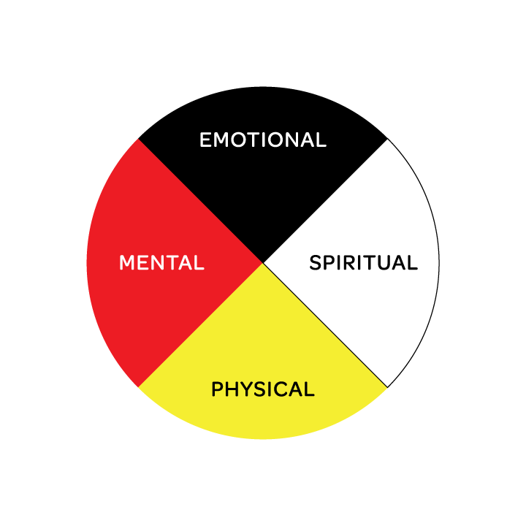
Lesson 1:
The Imbalance of Historical Trauma
What is trauma?
How do you think trauma can affect our bodies?
Notes:
Teacher Notes:
Introduce the lesson.
Ask the students to raise their hand if they have heard the word trauma. If most students do not raise their hand, then use the examples below to explain that trauma is what happens to a person or community when something harmful or stressful happens. If most students do raise their hand, ask them to think quietly about an example of trauma. Share the list below to see if these are some of the things they think could be traumatic. Emphasize that trauma is something that happens to everyone but sometimes events may seem more harmful or affect us more than we realize. For example,
Moving to a new city and leaving friends and family behind
Losing a loved one or a beloved pet
Being in car accident
Events such as pandemics, fires, storms, and other natural disasters
Notes for the teacher:
Keep in mind that discussions around trauma could bring up some difficult topics for some students if they have experienced trauma in their lives. Remind everyone that they don’t have to share personal experiences unless they want to, and to be respectful of one another when having these types of discussions.
3. Continue the discussion by asking them how they think experiencing trauma like the examples above can affect our emotions and our physical bodies.
4. This is the opportunity to lead into the next reading. Share with students that traumatic events that happened in the past can sometimes also leave impacts on families and communities. Natural disasters can force people to have to leave their homeland and lose their belongings and never return home. Wars can cause countries to change and separate families. When major traumatic experiences in the past cause a community or a people to feel emotional harm and long-lasting impact, this is called historical trauma. Then, share that in their reading, they are going to learn about historical trauma that Native American tribes still experience even when some of the events happened many years in the past.
Notes for the teacher:
If students probe additionally about examples of historical trauma, some examples that may be known to them would be the lasting effects of slavery on African-American community or the Holocaust for the Jewish people.

Slide 5
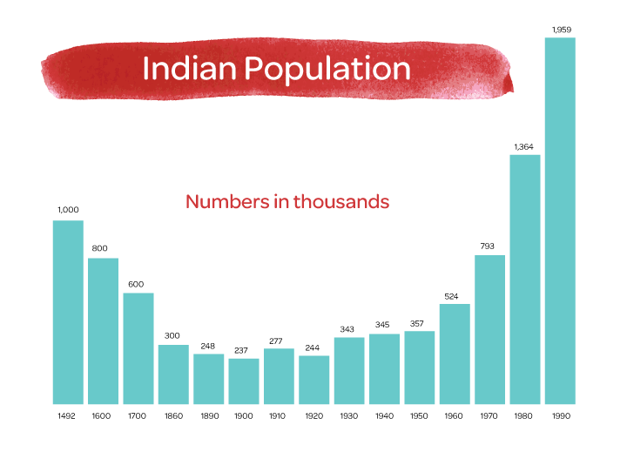
Storytelling: Resilience in the Face of Trauma
What is resilience?
Notes:
Teacher Notes:
Ensure that students have Handout 1: Resilience in the Face of Trauma. Ask students to read the story by Dr. Shane Doyle of the Apsaalooke Nation about generational trauma and the Indian Boarding School Movement.
Take a few minutes to find the Apsaalooke Nation on the map in handout 1. The Apsáalooke (Up-saw-low-gah) are also known as the Crow People, which is the name that the Europeans called them.
After they read the story, have them write down their thoughts on their own to the question, “What is resilience?”
Then, direct students’ attention to the map on page 3 of the handout. Ask students what they notice about the difference in the amount of land that Native tribes occupied at each date. Discuss the significance of where most of the reservations are located now. Also, ask students to share their noticing about the population growth chart in the corner of the map. Then ask students why the resiliency of Native people is so critical considering the land loss their ancestors have suffered.
Notes for the teacher:
This is another opportunity for a personalized lesson. Ask students to find where your community is located on the map. Are you close to any of these reservations? If so, what can you do to learn more? If not, how does that impact the demographics of your region and the amount of knowledge or lack of knowledge of native people in the United States?

Slide 6
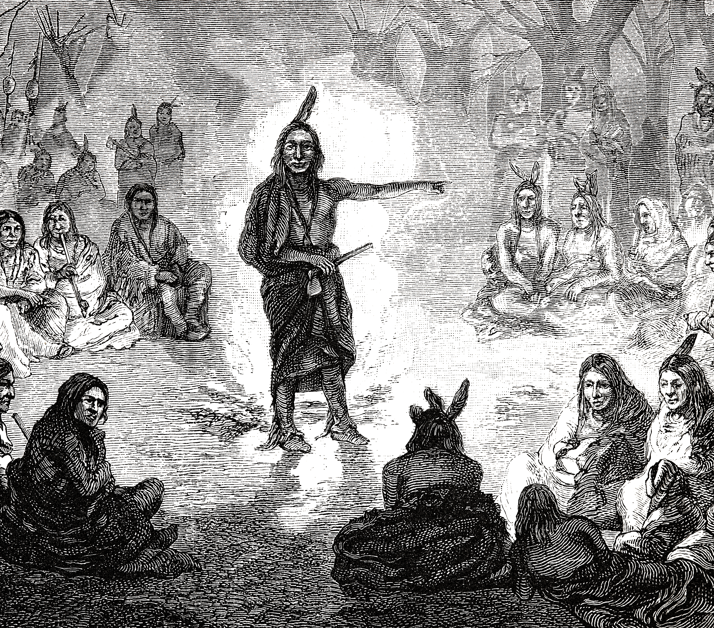
Talking Circle History and Protocol
How does a Talking Circle allow everyone to speak, and everyone’s voice to be heard?
How does it promote respect?
What are some group norms that we can all agree on during Talking Circles?
Notes:
Teacher Notes:
Provide students with Handout 2: Talking Circle History & Protocol, and read through this brief history and description of talking circles together. Ask students to raise their hand if they have ever participated in a talking circle or something similar. Call on these students to share their experiences with the class.
Tell the students that talking circles are going to be how discussions will take place in these lessons.
Discuss the following, together with the group of students
How do talking circles allow everyone’s voice to be heard?
How do they promote respect?
Ask the students to brainstorm some social norms that might be good to follow in talking circles. Tell them that “norms” are guidelines that everyone is expected to follow, in a social situation. Once the brainstorming ideas begin to slow down, ask the students to come to consensus on the norms that they will have in their talking circles.
Notes for the teacher:
Write the norms that everyone agrees on down in a place where they can remain, and where all of the students will be able to see them during talking circles.

Slide 7
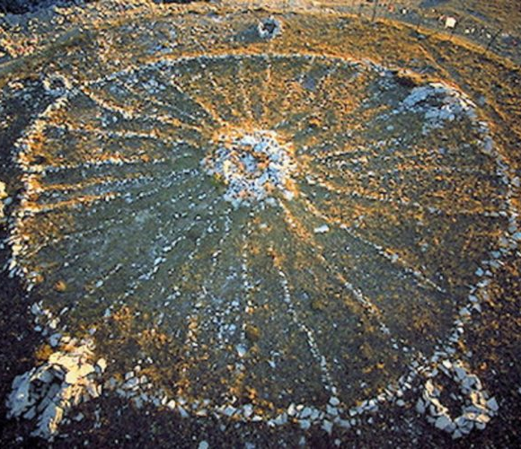
Talking Circle: Reflect and Respond
  What causes us stress in our everyday lives?
  How might the long-standing effects of
  historical trauma that is passed down through generations be similar to the stress we feel?
  How is it different?
  What kind of historical trauma may exist in our families and/or our community?
  In what ways can the image of the Medicine Wheel, that Dr. Doyle talked about in his story, help people to heal from historical trauma? How can it help to keep people mentally healthy?
Notes:
Teacher Notes:
Ask students to get into groups of 4-5 students to form talking circles.
Remind them to follow the group norms that were agreed upon and ask students to respond to some or all of the following questions/prompts with their talking circles.
What causes stress in our lives? How can it be helpful and/or harmful?
How might the long-standing effects of historical trauma that is passed down through generations be similar to the stress we feel? How is it different?
What kind of historical trauma may exist in our families and/or our community?
In what ways can the image of the Medicine Wheel, that Dr. Doyle talked about in his story, help people to heal from historical trauma? How can it help to keep people mentally healthy?

Slide 8
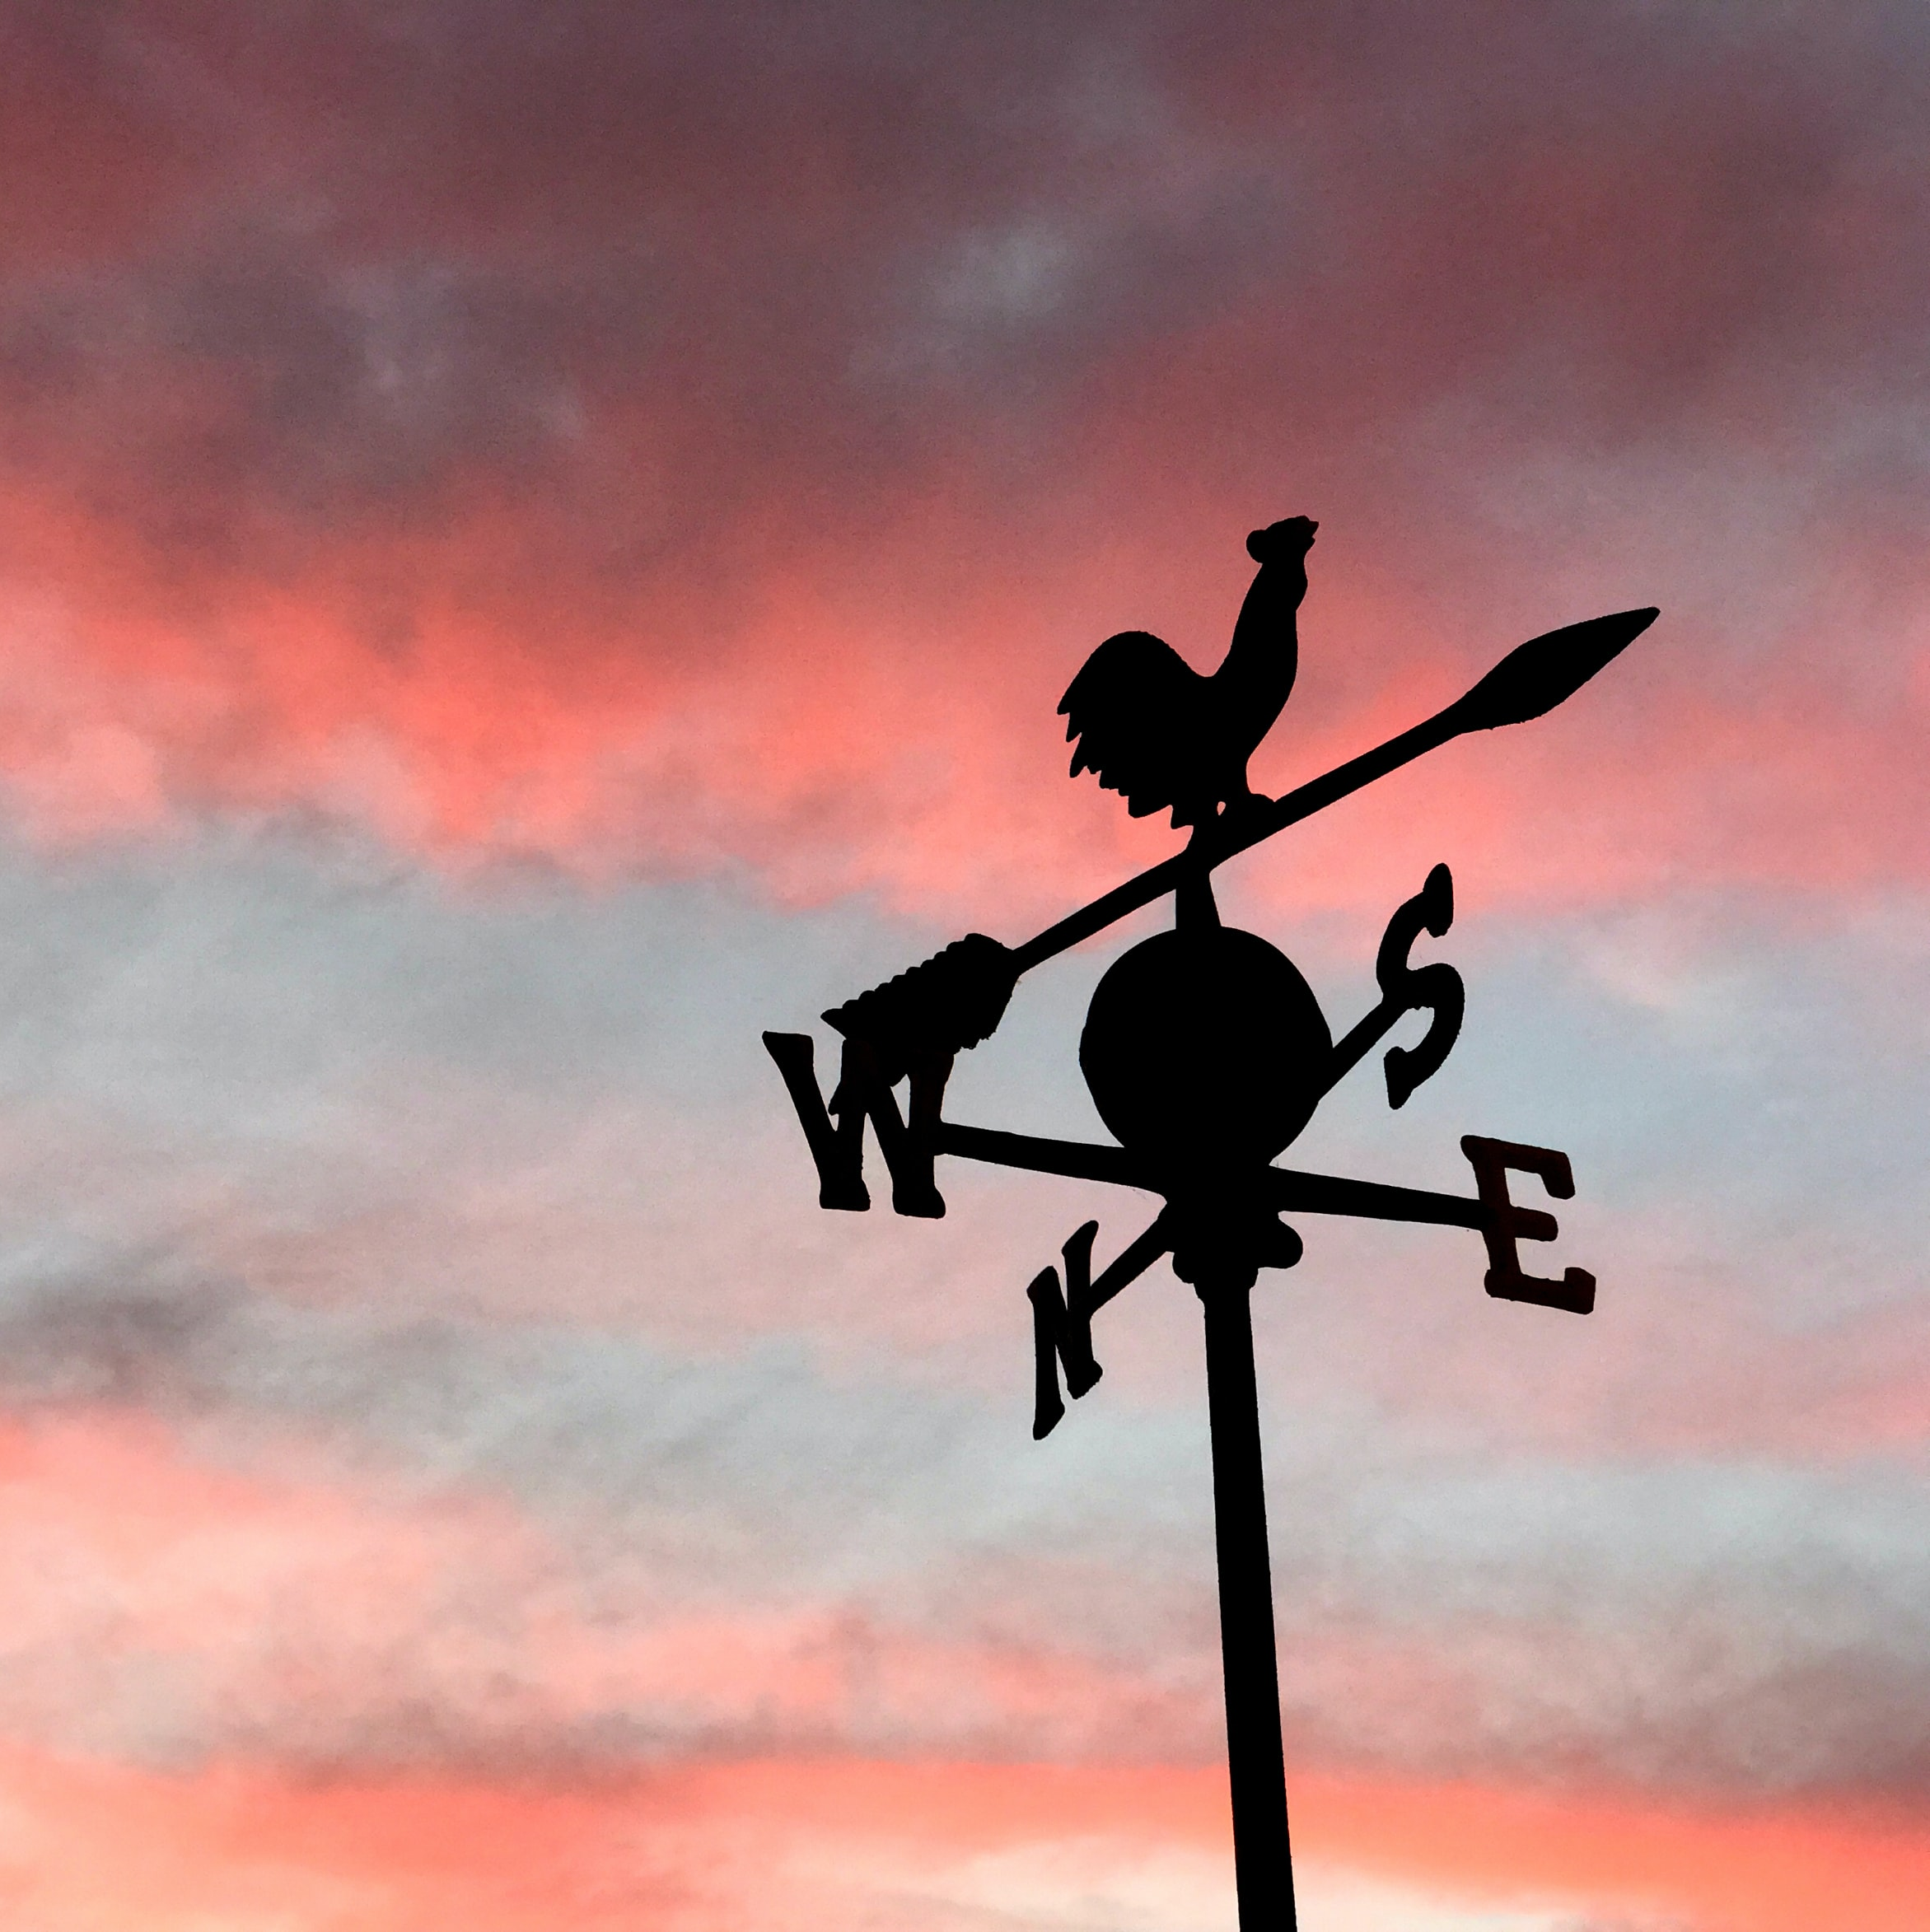
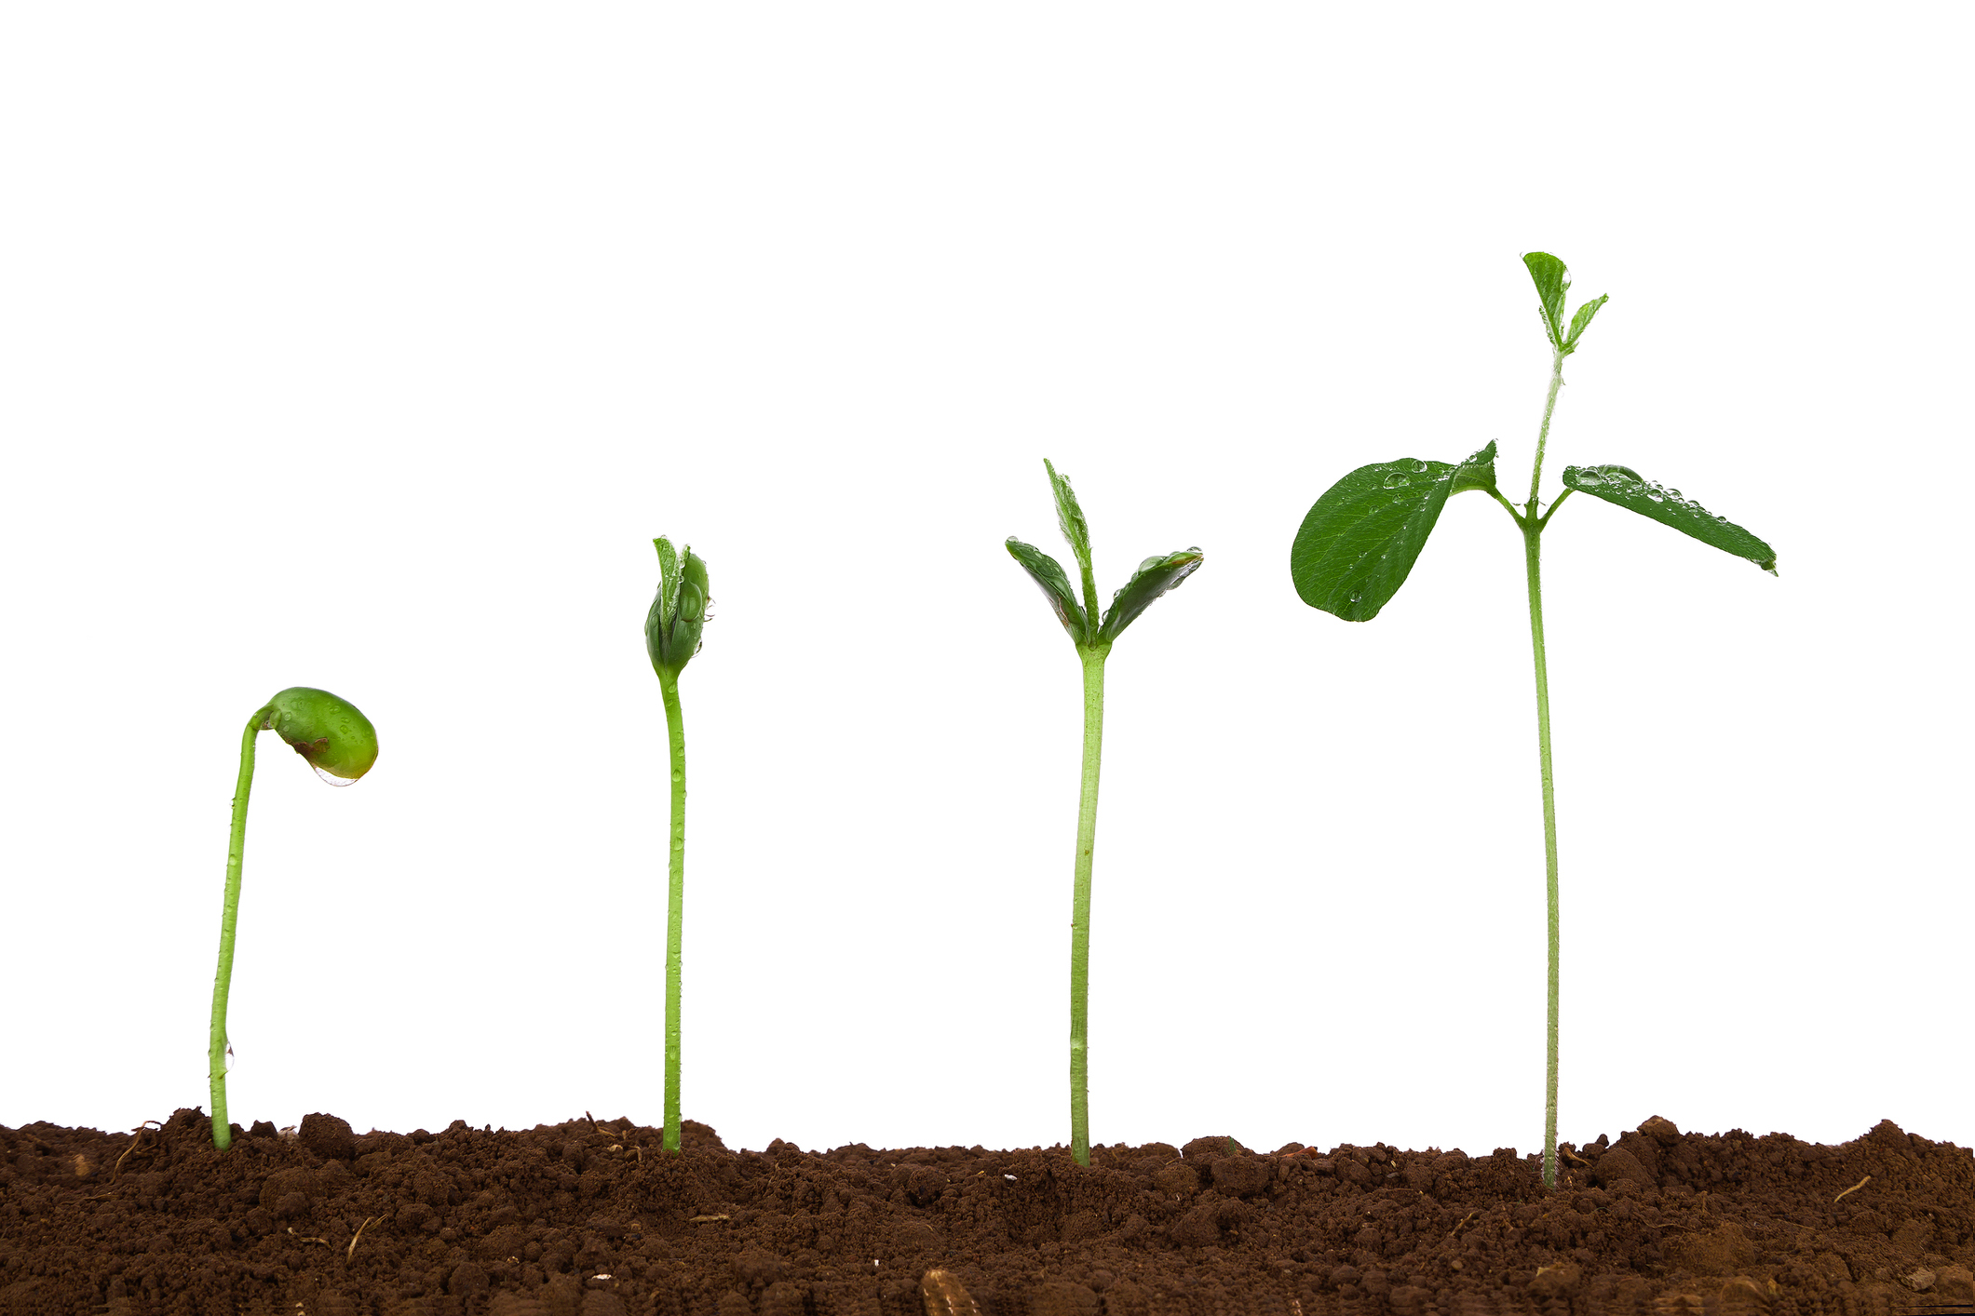
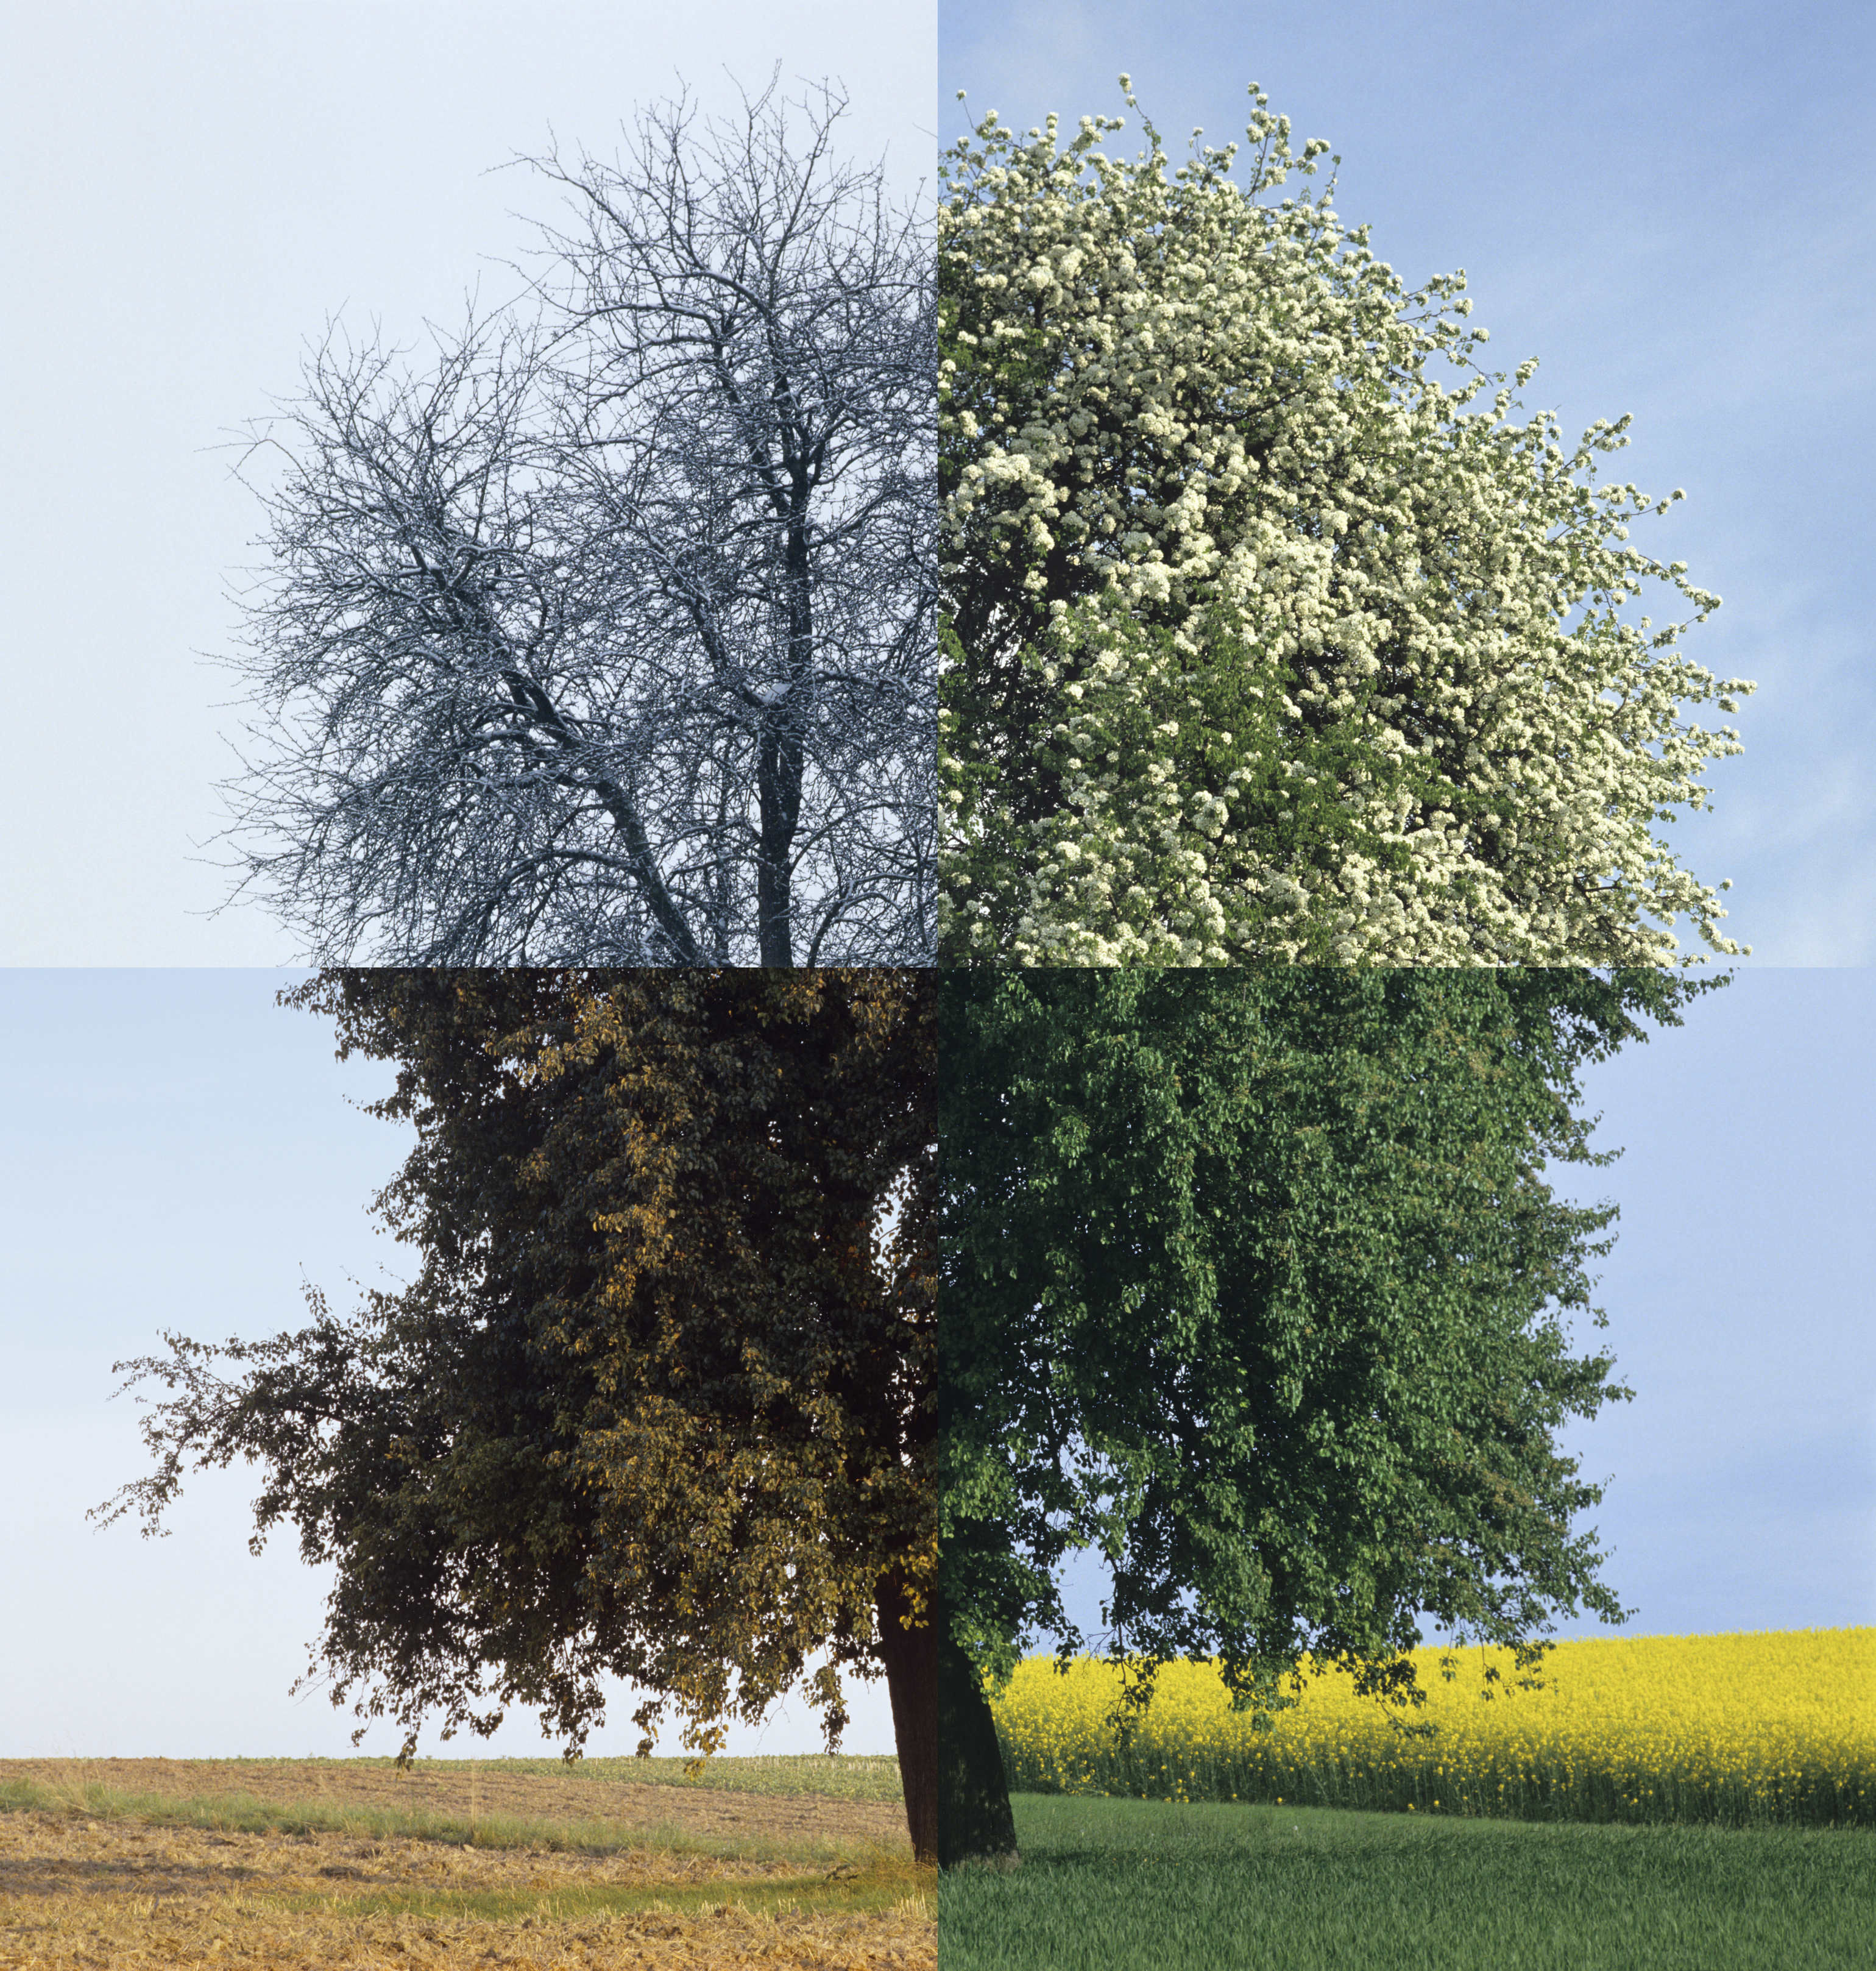
Lesson 2
The Medicine Wheel
What do you think the four directions of the Medicine Wheel might represent?
Notes:
Teacher Notes:
Introduce this lesson about the Medicine Wheel. If your students have completed Lesson 1, they have already seen one version of the Medicine Wheel that included heart, mind, spirit and body in the four quadrants.
Ask students to brainstorm out loud with the class about other ideas that the four directions or four quadrants can represent. Invite them to think about things that are important in their lives and remind them that a Medicine Wheel represents something in a balanced and harmonious way.

Slide 9
Storytelling: Connecting the Four Directions
Notes:
Teacher Notes:
Ensure that the students have Handout 3: Connecting the Four Directions. Ask students to read it to themselves while keeping in mind the image of the Medicine Wheel

Slide 10
Medicine Wheel Bingo!
Notes:
Teacher Notes:
After they have read the story in Handout 3, provide each student with their own bingo card that is included in Handout 4: Medicine Wheel Bingo.
Randomly call out an “activity” from the table in Handout 4 and ask the students to write the activity into the quadrant where they think it best belongs.
Continue to call out items from the table. Stop at a set time and invite students to share their “Medicine Wheel Bingo” card with the class.
Note: One of the purposes of this activity is to move students toward realizing many of the things we deal with or feel can fall into multiple quadrants because things that take place in our lives affects us as a whole, and all quadrants of the Medicine Wheel are connected.
After the game has been played for some time, invite students to come up with their own “personal health activities” to add to the list.

Slide 11
Talking Circle: Reflect and Respond
What does the Medicine Wheel teach
us about American Indian/Alaska
Native traditional knowledge
and understanding?
How are the physical, emotional, intellectual, and spiritual aspects of our selves connected?
What is the impact of changing one of the Medicine Wheel components? What is their relationship to one another?
Notes:
Teacher Notes:
Invite students to form talking circle groups of 4-5 students each.
Notes for the teacher:
Talking circles are an ancient and important part of many Native American communities. They are a simple and valuable way to communicate our feelings to a group and, in doing so, we form a respectful and compassionate community.
Protocol: Sit in a circle and prepare to listen and share. The talking circle can be focused on any topic or issue. Each person has the opportunity to speak when they are holding the stick, feather, or other object used to identify whose turn it is to speak. The circle is complete when everyone has an opportunity to speak once, and most discussions have two or more opportunities for individuals to speak.
2. Ask students to discuss all or some of the following questions in their talking circles, reminding them of the talking circle norms that were agreed upon in the earlier lesson.
What does the Medicine Wheel teach us about American Indian/Alaska Native traditional knowledge and understanding?
How are physical, emotional, intellectual, and spiritual parts of our selves connected?
What is the impact of changing one of the Medicine Wheel components? What is their relationship to one another?

Slide 12
Lesson 3
Balancing Our Own Medicine Wheel
How do we become imbalanced?
What do I do in my own life to live a balanced and harmonious life?
How do substances like opioids or other medications (which are intended to help) lead to imbalance?
Notes:
Teacher Notes:
If the students completed Lesson 2 focused on learning about the Medicine Wheel, introduce this lesson by reviewing what was discussed in the activities from Lesson 2.
Invite students to write down their responses to the following questions:
How do we become imbalanced in our lives?
What are some things that I do to heal and try to live a harmonious and balanced life when I feel imbalanced ?
How do substances like opioids, other medications (which are sometimes intended to help), or other unhealthy practices lead to imbalance?
Notes for the teacher:
Because this topic is focused on personal information, students may not feel comfortable sharing what they write for this activity with the class. It is important to acknowledge this and let them know that while they are not required to share their personal information with others, they are encouraged to think about areas of imbalance in their lives and how they move their lives toward harmony and balance
Ask students to share their responses with the group, if they feel comfortable.
I know that we discussed these lessons standing on their own. Is it better not to refer to a past lesson at all?

Slide 13
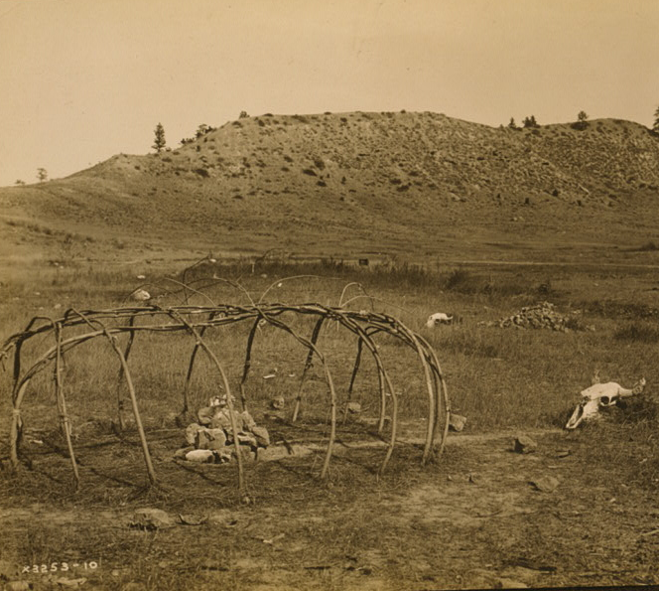
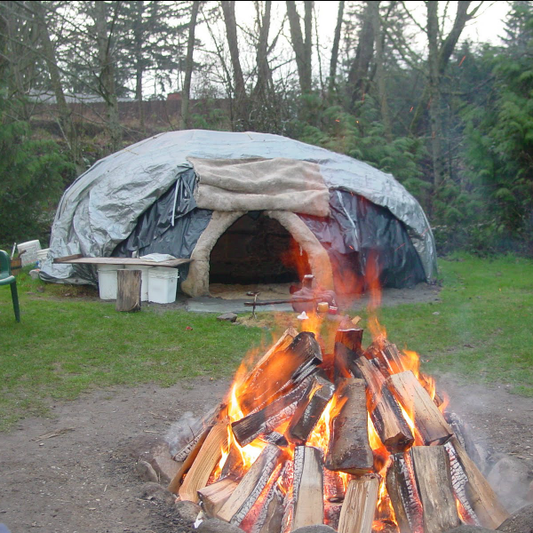
Storytelling: The Healing of Ceremony
Notes:
Teacher Notes:
Ensure that students have Student Handout 5: The Healing of Ceremony.
Invite the students to read this story on their own.

Slide 14
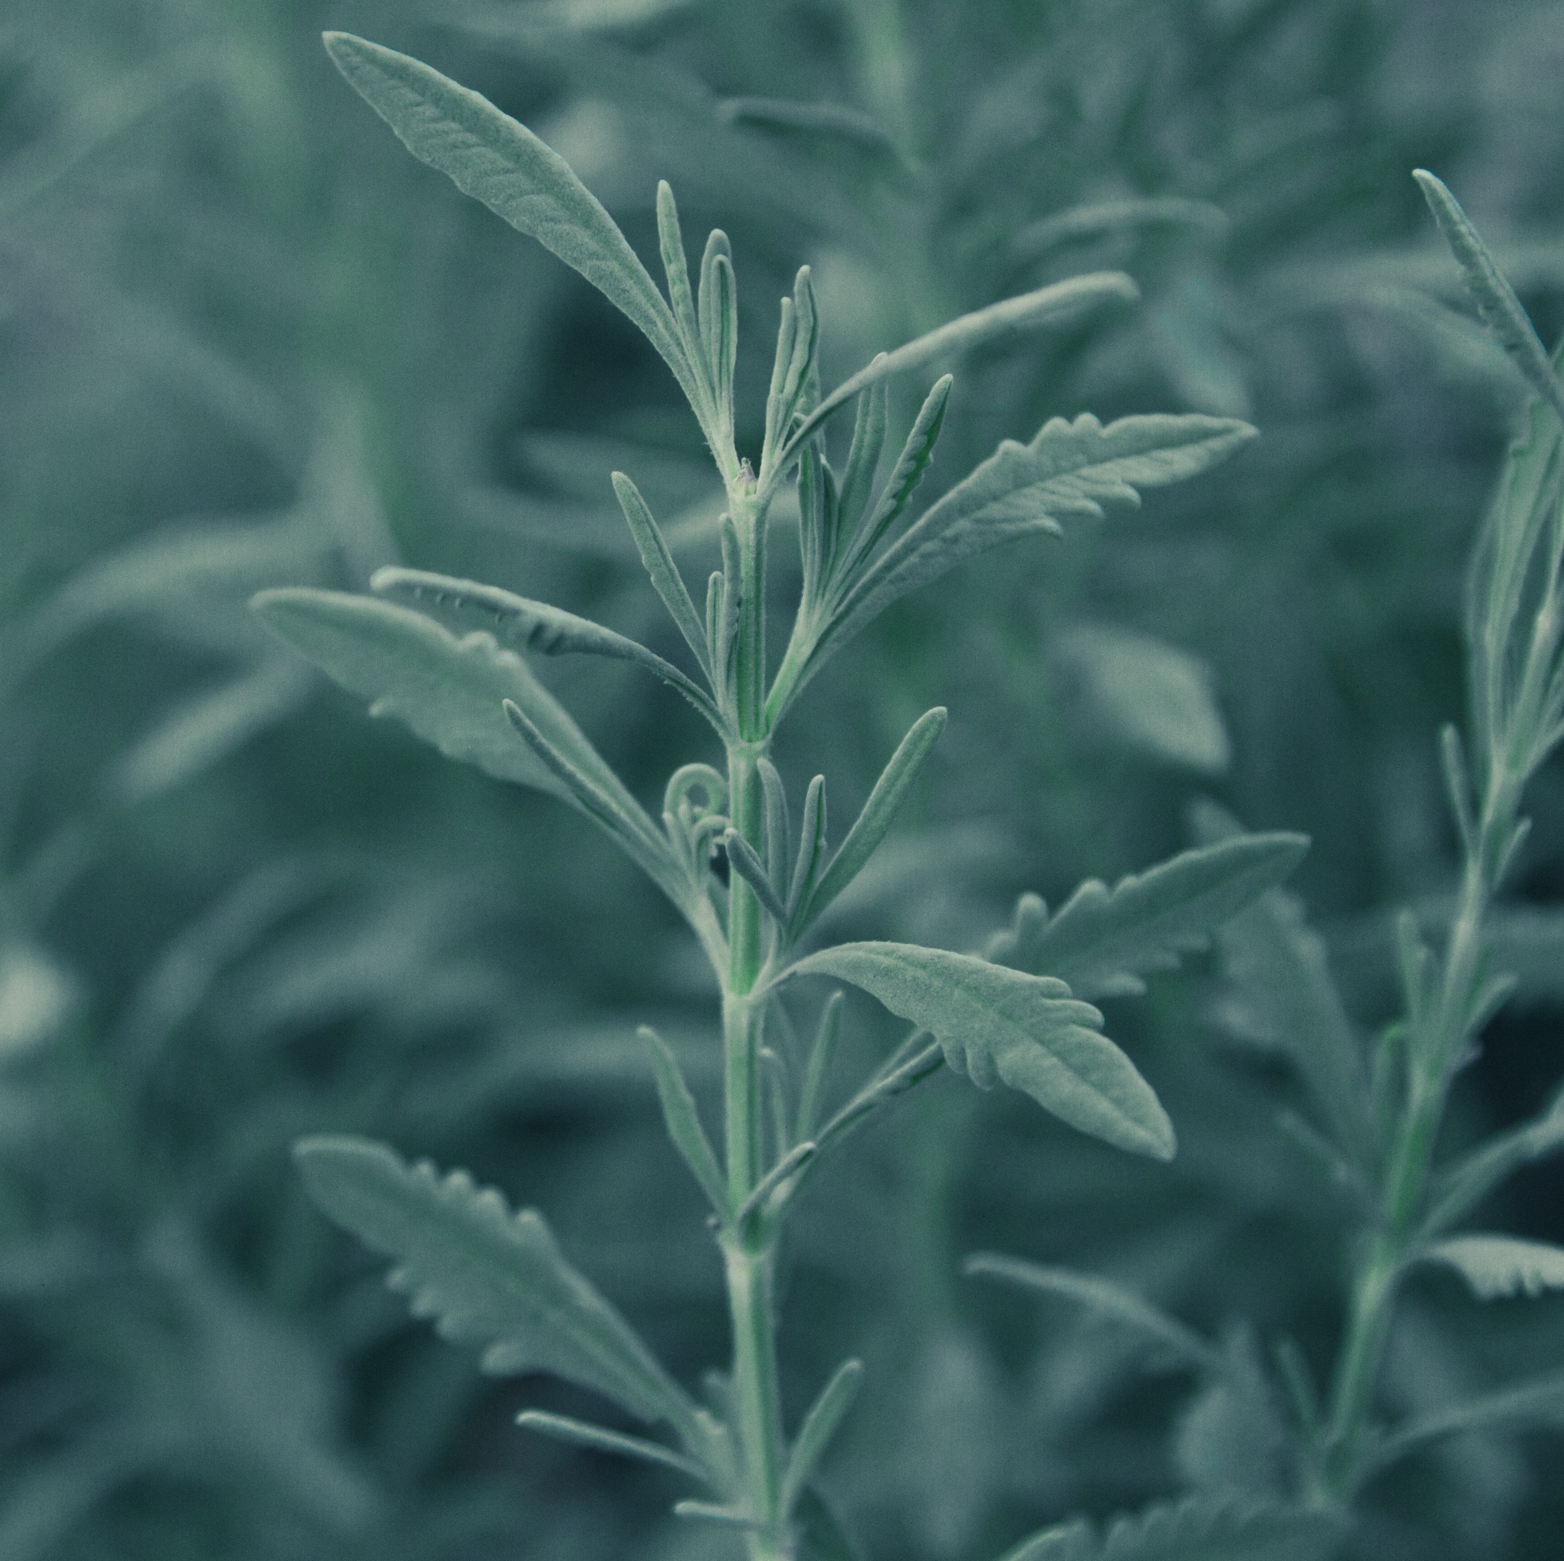
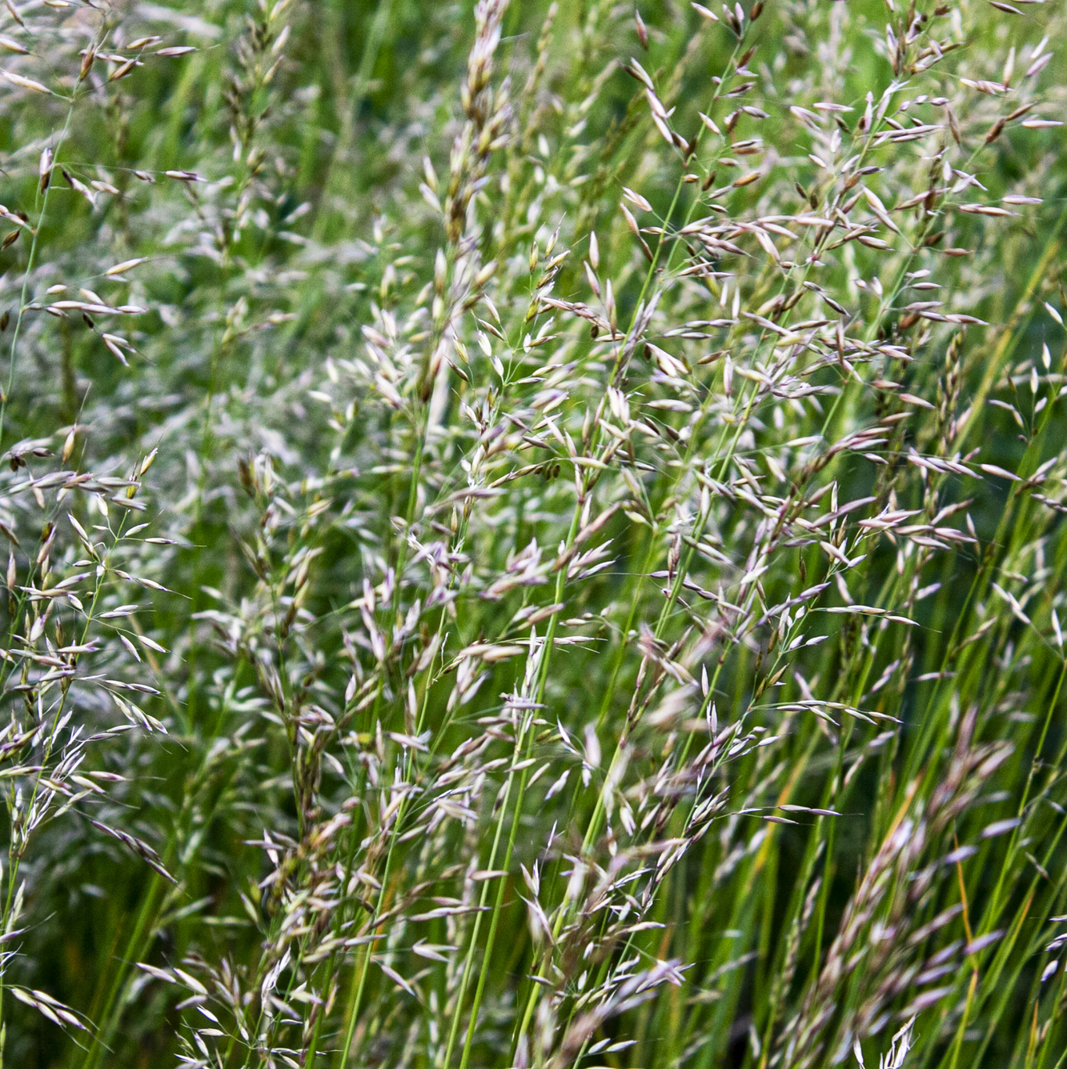
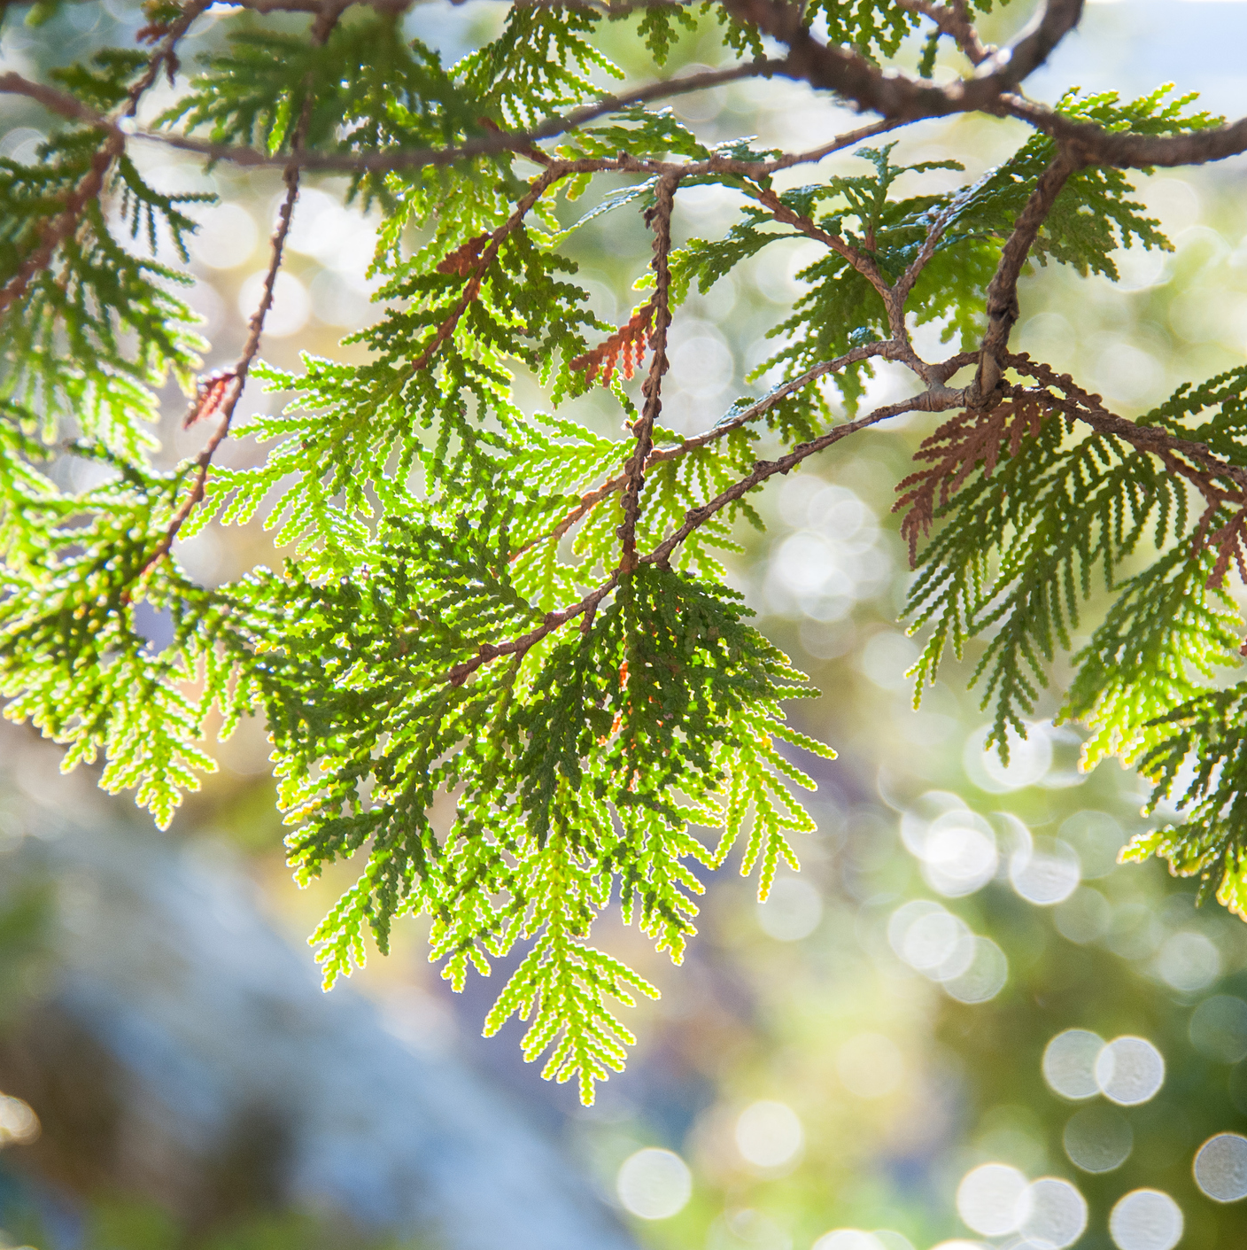
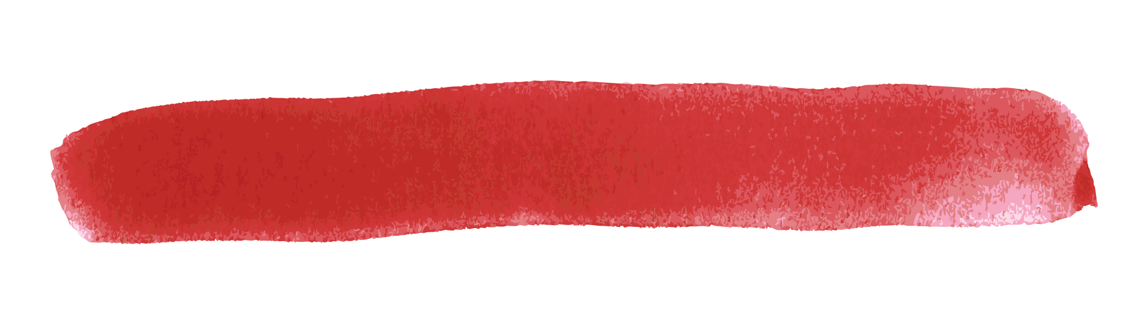
Storytelling: The Healing of Traditional Medicine and Dance
Sage
Sweet Grass
Cedar
Notes:
Teacher Notes:
Ensure that students have Student Handout 6: The Healing of Traditional Medicine and Student Handout 7: The Healing of Dance.
As them to read these stories out loud either in small groups or with the larger class.

Slide 15
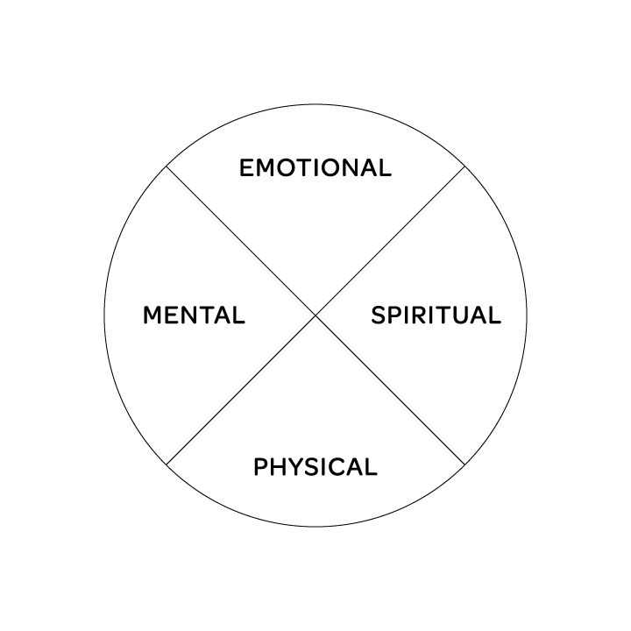
My Medicine Wheel
What activities, relationships, or values are in the four quadrants of your own medicine wheel?
Physical
Emotional
Mental
Spiritual
Notes:
Teacher Notes:
Introduce this activity by inviting students to think about the stories that they have just read about healing, and to reflect on some things in their life that help them to live a balanced life.
Invite students to fill in Student Handout 8: My Medicine Wheel, choosing quadrants that they can relate to and listing activities or elements within those quadrants that demonstrate their lives and contribute to who they are. Encourage them to utilize words, drawings, colors, or anything else that demonstrates all of the pieces that they balance in their lives.

Slide 16
Talking Circle: Reflect and Respond
Which quadrant of your Medicine Wheel are you the most focused on at this time in your life?
What are some things in your life that tend to disrupt the balance in your Medicine Wheel (relationships, social media, illnesses, trauma, etc.)?
Discuss what you read about traditional ways of healing and reflect on your own life and healthy ways to find balance.
Notes:
Teacher Notes:
As a wrap-up, ask students to share their personal Medicine Wheel in a talking circle. If they are not comfortable sharing their personal Medicine Wheel, ask them to write a reflection that addresses the following:
Which quadrant are you the most focused on at this time in your life?
What are some things in your life that tend to disrupt the balance in your Medicine Wheel (relationships, social media, illnesses, trauma, etc.)?
Discuss what you learned about traditional ways of healing, and how this might help you think about healthier ways to find balance in your life.
Notes for the teacher:
Talking circles are an ancient and important part of many Native American communities. They are a simple and valuable way to communicate our feelings to a group and, in doing so, we form a respectful and compassionate community.
Protocol: Sit in a circle and prepare to listen and share. The talking circle can be focused on any topic or issue. Each person has the opportunity to speak when they are holding the stick, feather, or other object used to identify whose turn it is to speak. The circle is complete when everyone has an opportunity to speak once, and most discussions have two or more opportunities for individuals to speak.

Slide 17
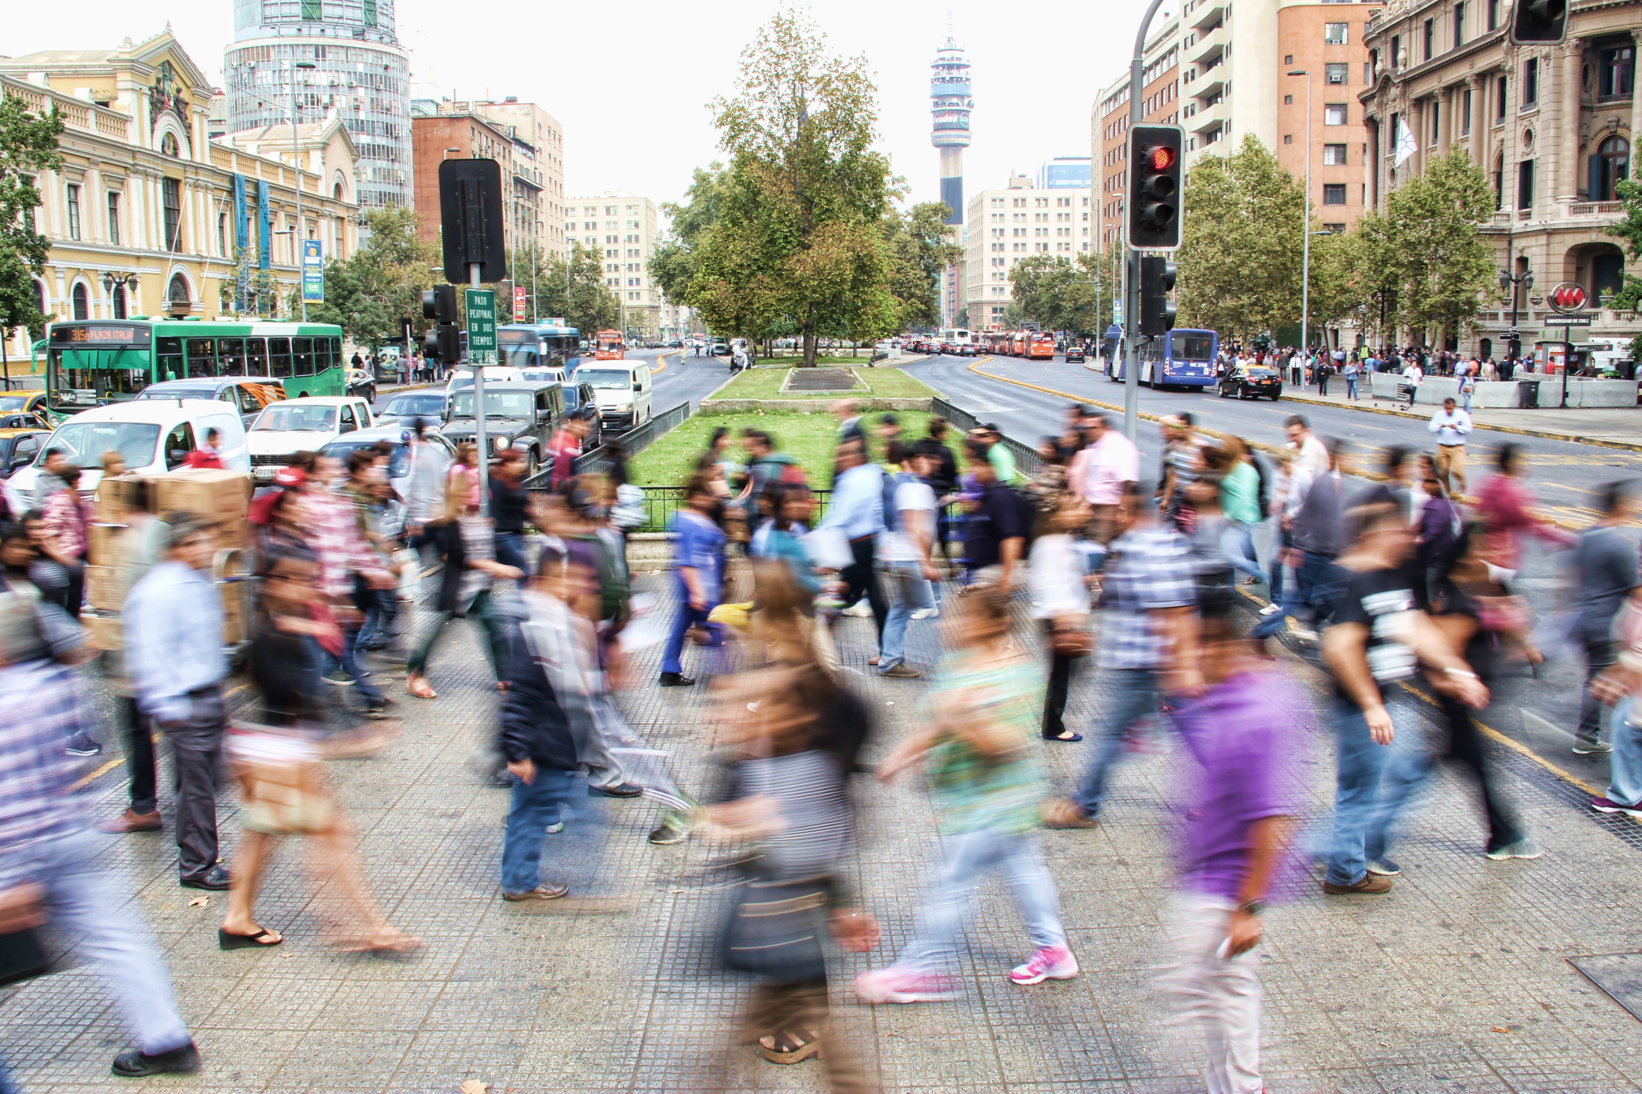
Lesson 4
The Power of Community
What keeps a community
in balance?
What can throw a community out of balance?
Notes:
Teacher Notes:
Introduce this lesson with a classroom brainstorm in response to the questions:
“What keeps a community in balance?
What can throw a community out of balance?
Consider having students brainstorm what community means and what kinds of communities they are a part of. Emphasize that their class is a community.

Slide 18
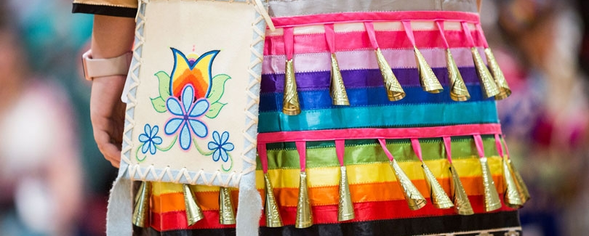
Storytelling: Maintaining Balance and Harmony in Our Communities
Notes:
Teacher Notes:
Ensure that students have Student Handout 9: Maintaining Balance and Harmony in Our Communities and Student Handout 10: The History of the Jingle Dress Dance.
Invite them to read both of these handouts in preparation for the next two activities.

Slide 19
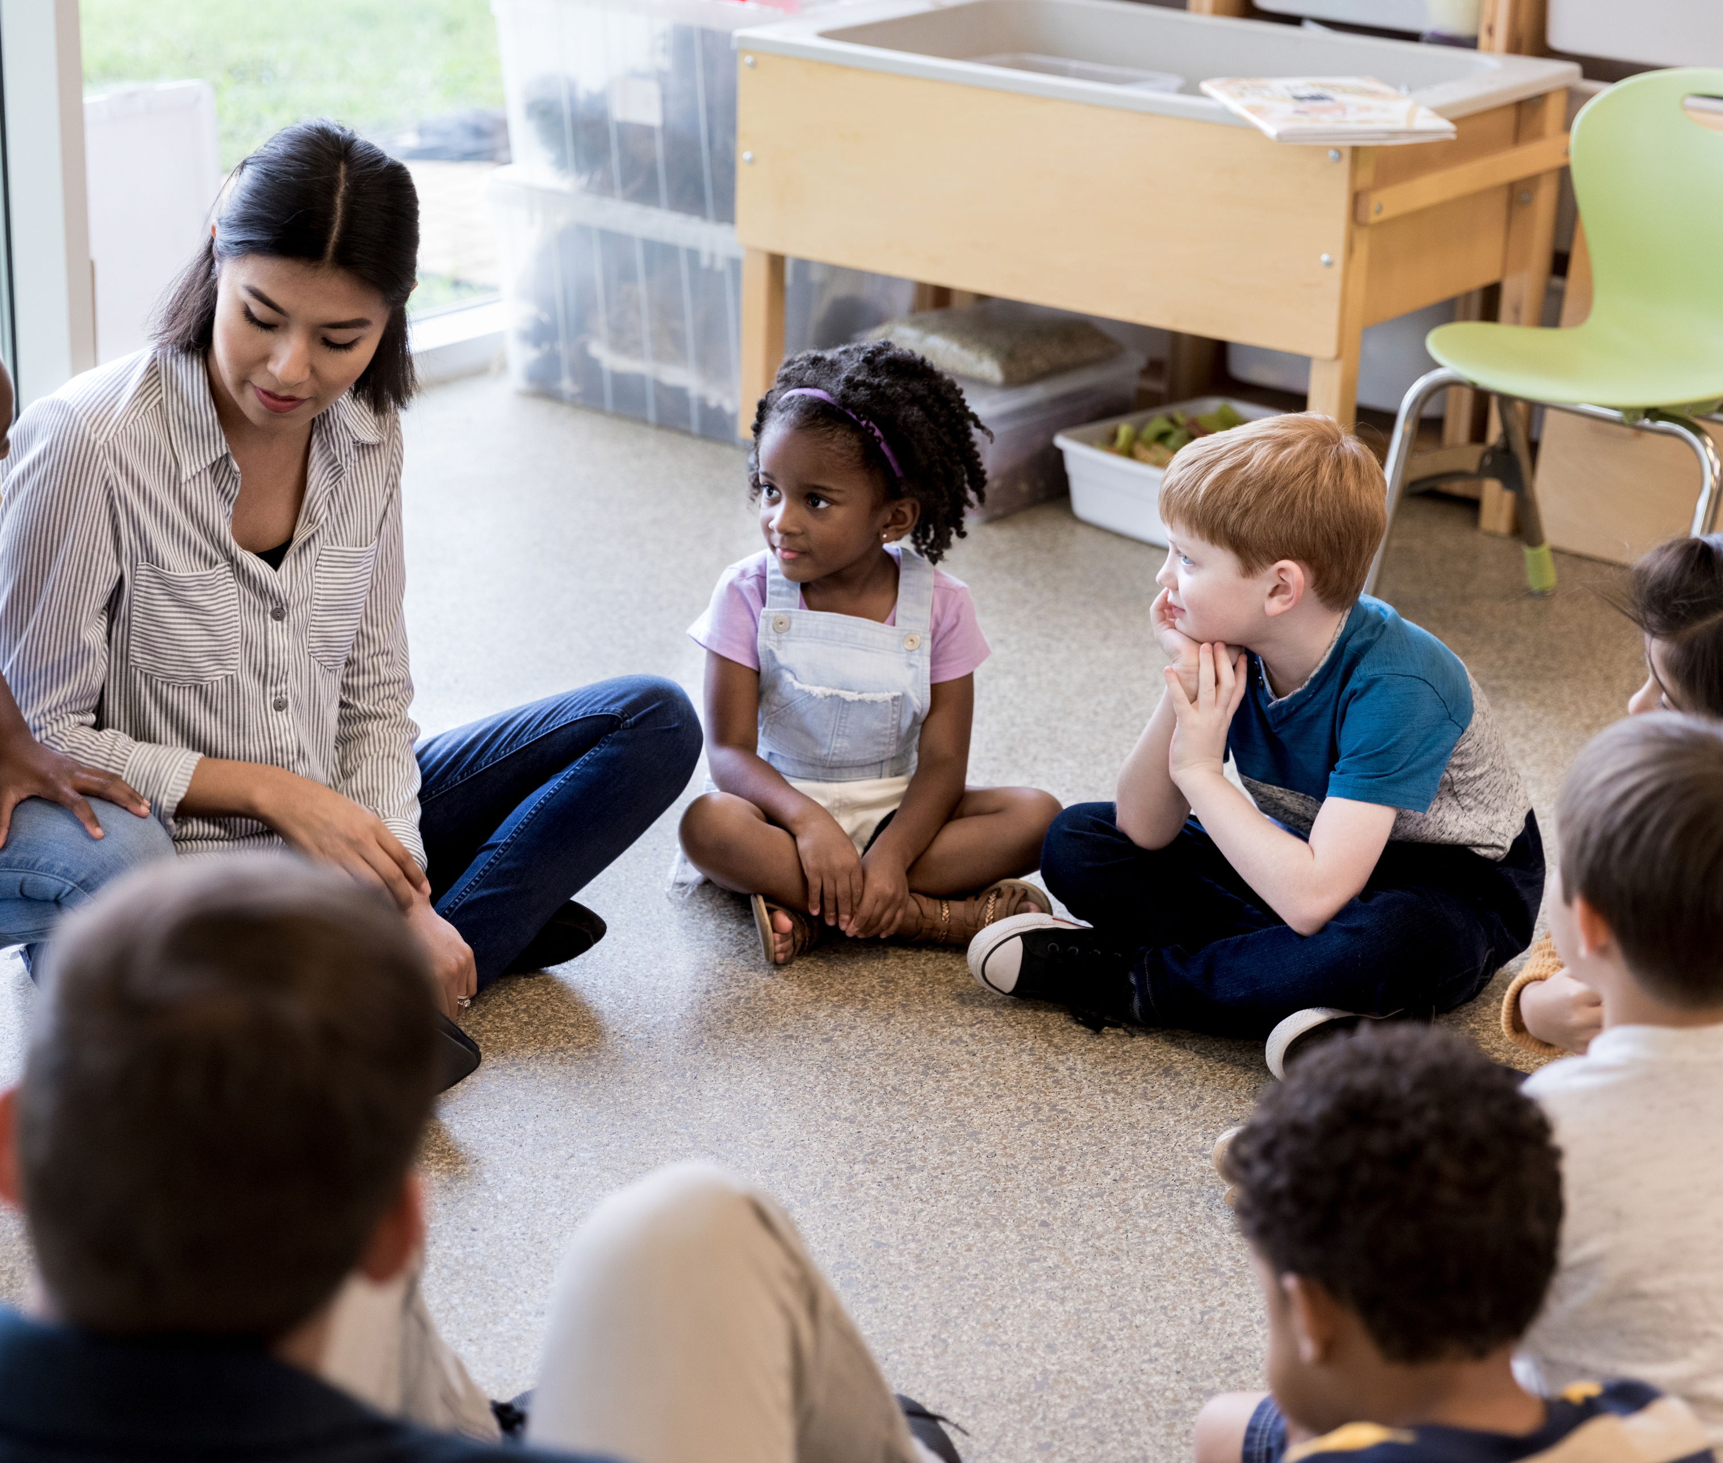
Classroom Medicine Wheel
Pride
Wellness
Celebration
Calm
Learning
Structures
Relationship
Notes:
Teacher Notes:
Develop a Classroom Medicine Wheel with the students, that incorporates four aspects of the classroom that need to remain in balance in order to keep the classroom balanced. As you are doing this activity, facilitate and promote the student thinking with the following prompts:
Like the jingle dress dancing, can you think of any ceremonies or rituals that represent pride, wellness, and celebration in our classroom?
Are there things that work to “purify” the classroom space, help with de-stressing and create a healthy setting for learning (i.e. sunlight, artwork, furniture)?
Are there any practices that, like the adopting practices of the Apsáalooke (Crow ) people, work to strengthen relationships in the classroom?
What categories do these things fall into? For example, is the physical space important to keep the classroom in balance? Are the relationships with one another a key aspect of a balanced classroom?
This is the first time that the word “crow” has appeared after this word in parenthesis.

Slide 20
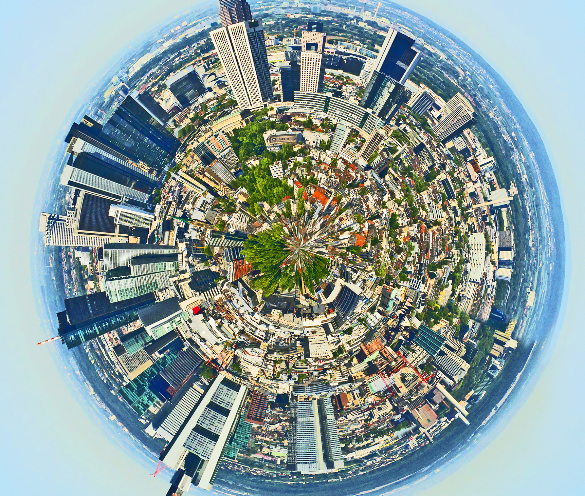
Classroom Medicine Wheel
Family
Sports Team
Neighborhood
Religious Community
Town
Gaming Community
Music Group
Notes:
Teacher Notes:
Ask students to think about communities that they are a member of, such as their family, a sports team, or the neighborhood or town they live in. Ask them to create a Medicine Wheel for that particular community .

Slide 21
Talking Circle: Reflect and Respond
What ensures this community stays in harmony and balance? What are some examples of imbalance that could affect this community?
What is your role in the community you chose for this activity?
How does your role play a part in keeping the community in balance?
Notes:
Teacher Notes:
Invite students to form talking circles.
Notes for the teacher:
Talking circles are an ancient and important part of many Native American communities. They are a simple and valuable way to communicate our feelings to a group and, in doing so, we form a respectful and compassionate community.
Protocol: Sit in a circle and prepare to listen and share. The Talking Circle can be focused on any topic or issue. Each person has the opportunity to speak when they are holding the stick, feather, or other object used to identify whose turn it is to speak. The circle is complete when everyone has an opportunity to speak once, and most discussions have two or more opportunities for individuals to speak.
2. In the talking circle, ask students to share their Community Medicine Wheel, and respond to the following questions:
What ensures that this community stays in harmony and balance?
What are some examples of imbalance that could impact this community?
What is your role in the community that you chose for this activity?
How does your role play a part in keeping the community in balance?

